Slide 1

Data Structure &
Algorithm - Self Placed
8 Week Summer Training By Geeks For GeekForGeeks
Course Code – CSE 443
University Name – Lovely Professional University
Submitted By
Name – Sumit kumar Bhagat
REG No - 12012276

Slide 2
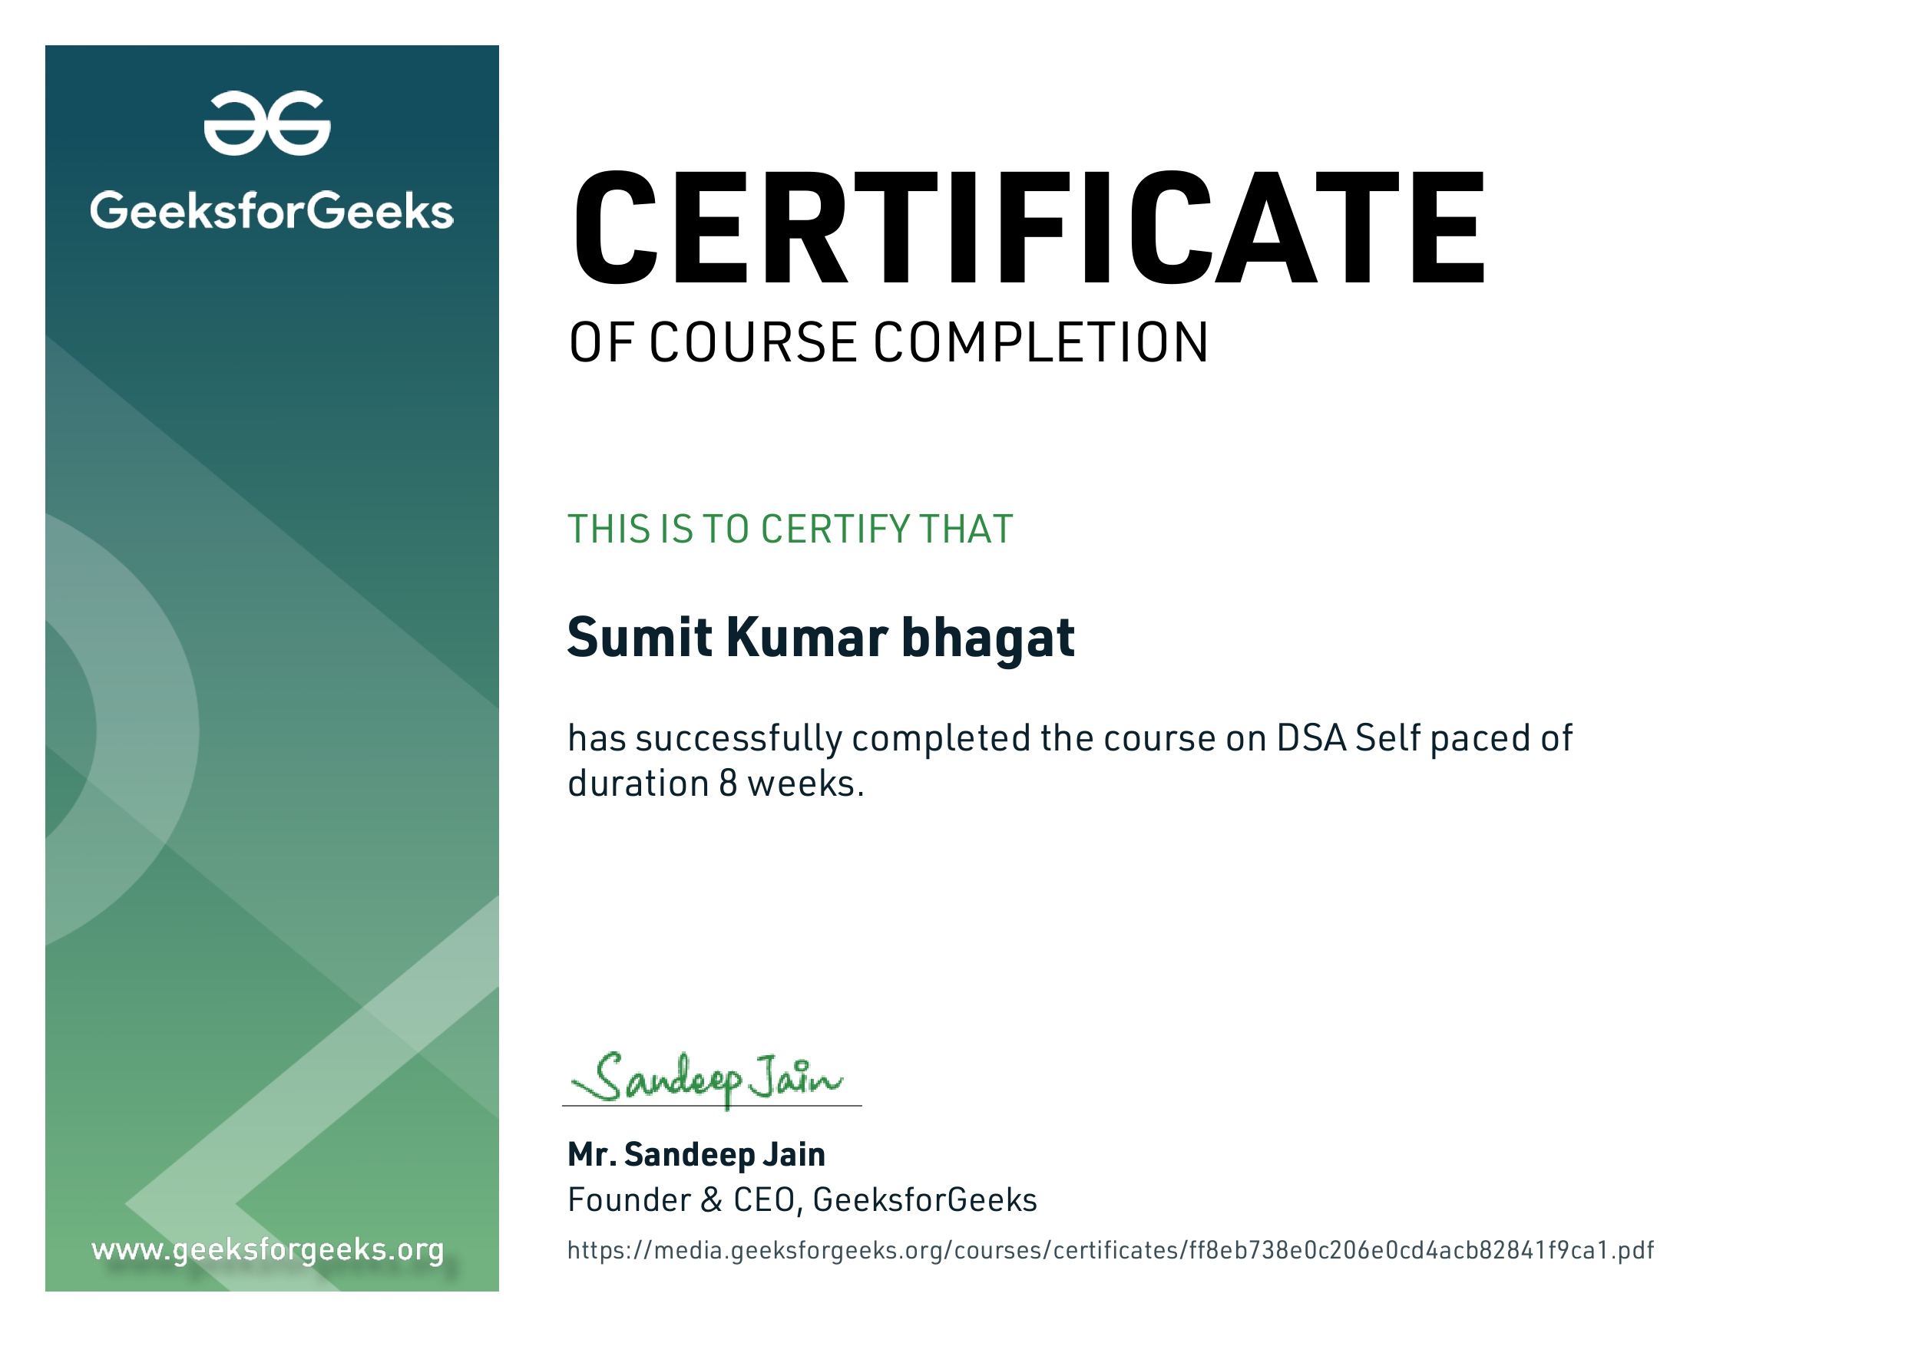
CERTIFICATION

Slide 3

ABOUT SUMMER TRAINING
CONCEPTS - 1
CONCEPTS - 2
CONCEPTS - 3
We followed a structured methodology for our 8 Weeks Summer training Program by Geeks for Geeks DSA Self-Paced course.
Which starts from Basic data structures like Arrays, Strings and recursion to the implementation of hard algorithms like Dynamic programming, Segment trees and Backtracking.
And at the end prepared a Well planned mini Project Shortest Path Finder
( Dijkstra’s Algorithm) in which we will see how to find the shortest path between any two vertices of a graph. We will also visualize the time complexity of Dijkstra’s Algorithm which is O(E Log V)

Slide 4
ORGANIZATION INFORMATION
CONTENT - 1
CONTENT - 2
CONTENT - 3
With the idea of imparting programming knowledge, Mr. Sandeep Jain, an IIT Roorkee alumnus started a dream, GeeksforGeeks. Whether programming excites you or you feel stifled, wondering how to prepare for interview questions or how to ace data structures and algorithms, GeeksforGeeks is a one stop solution.
With every tick of time, they are adding arrows in our quiver. From articles on various computer science subjects to programming problems for practice, from basic to premium courses, from technologies to entrance examinations, they have been building ample content with superior quality.
In a short span, they have built a community of 1 Million+ Geeks around the world, 20,000+ Contributors and 500+ Campus Ambassadors in various colleges across the nation. Their success stories include a lot of students who benefitted in their placements and landed jobs at tech giants. Their vision is to build a gigantic network of geeks and there are only a fraction of it yet.

Slide 5
WHY THIS
COURSE I CHOOSE
1.
2.
3.
This course is a complete package that helped me learn Data Structures and Algorithms from basic to an advanced level. The course curriculum has been divided into 8 weeks where one can practice questions & attempt the assessment tests according to his own pace.
The course offers me a wealth of programming challenges that will help me to prepare for interviews with top-notch companies like Microsoft, Amazon, Adobe etc.
Data structures and algorithms (DSA) goes through solutions to standard problems in detail and gives you an insight into how efficient it is to use each one of them. It also teaches you the science of evaluating the efficiency of an algorithm. This enables you to choose the best of various choices.

Slide 6

WHY DATA STRUCTURE & ALGORITHM IS IMPORTANT ?
(1) All product-based company recruitment drives to test the problem-solving skills of the candidate. This is essential because the problems that such companies come across daily are quite huge and complex, and they want to hire people who will be able to solve these tasks within minimal time and the least number of resources. Advanced knowledge of Data Structures and Algorithms is a clear indicator of the person’s abilities in solving complex problems in minimal time. Hence, such companies directly hire people who are good Data structure and algorithms. The first level of any company, that is the online test round consists of questions revolving around various data structures. Even in startups along with app/web development, DSA is extremely important. The startups initially check for basic problem-solving skills, then move on to develop skills along with data structures and algorithm design testing.
(2) Writing optimized code is extremely useful in companies. It is very critical for companies to hire people who can write the most optimized code as it helps in limiting the resource use of the companies. So, get in the habit of writing the most optimized solution in terms of time and space. Choose the data structure that is the best fit and require the least space and the algorithm that executes the code in the least time.
(3) One can grasp a good hold on development skills like web development, app development, machine learning etc only when the basics are clear. It is necessary to know the backend details of every technology, every code and function. For instance, if your Facebook feed is taking too long to update, you would definitely not feel like using that app. Hence it is very important for programmers to write optimized code that loads within microseconds. In machine learning, if the data is being fetched quickly then it’s the programmer behind it who has chosen an appropriate data structure.

Slide 7
TECHNOLOGY TO LEARN
1. Analysis
of
common loops
2. Analysis
of
Recursion
3. Time
&
Space Complexity
4. Array
&
String
5. Searching
&
Sorting
6. Stacks, Queues
&
Deque
7. Linked List
&
Recursion
8. Heap
&
Hashing
9. Tree
&
AVL Tree
10. Greedy
&
Dynamic
Programming
11. Graph
&
Binary Search Tree
12. Backtracking
&
Disjoint Set

Slide 8
Dijkstra’s Algorithm or Shortest Path First (SPF)
Dijkstra's Algorithm basically starts at the node that you choose (the source node) and it analyzes the graph to find the shortest path between that node and all the other nodes in the graph.
The algorithm keeps track of the currently known shortest distance from each node to the source node and it updates these values if it finds a shorter path.
Once the algorithm has found the shortest path between the source node and another node, that node is marked as "visited" and added to the path.
The process continues until all the nodes in the graph have been added to the path. This way, we have a path that connects the source node to all other nodes following the shortest path possible to reach each node.

Slide 9
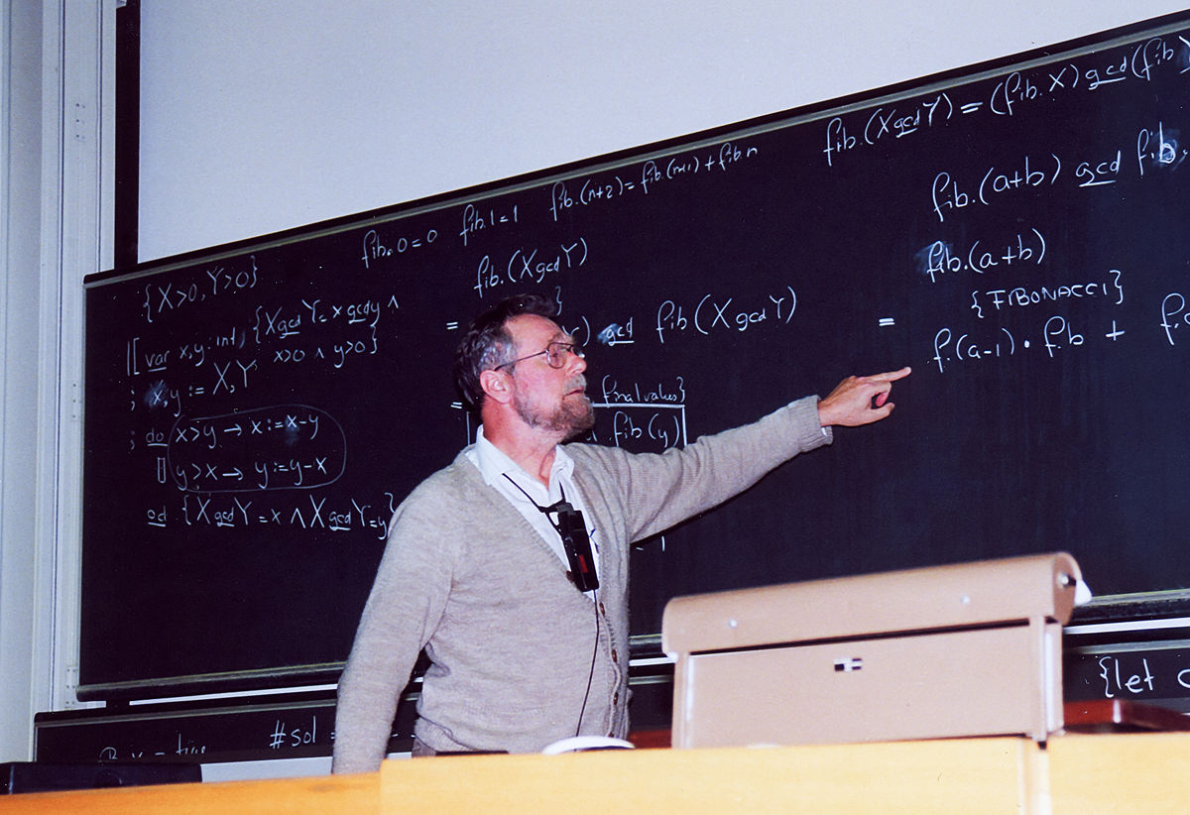
Edsger W. Dijkstra (1930-2002)
Dutch Computer Scientist
Received Turing Award for contribution to developing programming languages.
Contributed to :
Shortest path-algorithm, also known as Dijkstra's algorithm;
Reverse Polish Notation and related Shunting yard algorithm; t
THE multiprogramming system;
Banker's algorithm;
Self-stabilization – an alternative way to ensure the reliability of the system.

Slide 10
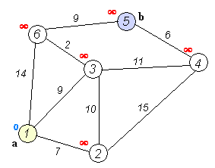
Shortest Path Algorithm :
This algorithm has been used in GPS navigating systems.
For a given source vertex (node) in the graph, the algorithm can be used to find shortest path from a single starting vertex to a single destination vertex.
For example, if the vertices of the graph represent cities and edge path costs represent driving distances between pairs of cities connected by a direct road, Dijkstra's algorithm can be used to find the shortest route between one city (a) and destination city (b).

Slide 11
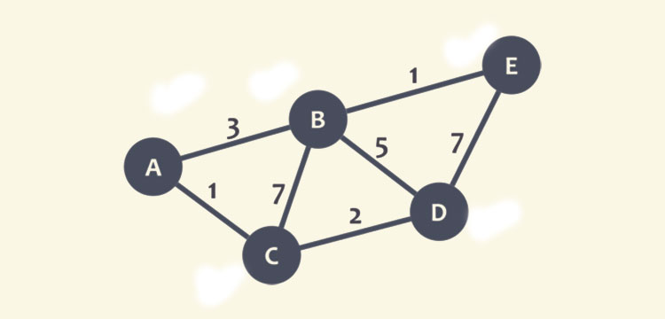
Example of shortest path first (SPF):
During the execution of the algorithm, each node will be marked with its minimum distance to node C as we have selected node C.
In this case, the minimum distance is 0 for node C. Also, for the rest of the nodes, as we don’t know this distance, they will be marked as infinity (∞), except node C (currently marked as red dot).
Graphical Representation of Node C as Current Node

Slide 12
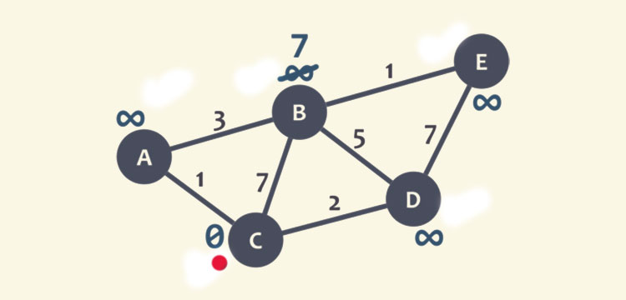
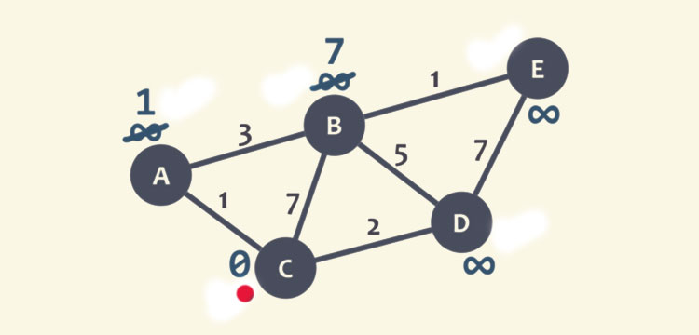
STEP 2
STEP 3
Now the neighbours of node C will be checked, i.e, node A, B, and D. We start with B, here we will add the minimum distance of current node (0) with the weight of the edge (7) that linked the node C to node B and get 0+ 7= 7.
Now, this value will be compared with the minimum distance of B (infinity), the least value is the one that remains the minimum distance of B, like in this case, 7 is less than infinity, and marks the least value to node B.
Now, the same process is checked with neighbour A. We add 0 with 1 (weight of edge that connects node C to A), and get 1.
Again, 1 is compared with the minimum distance of A (infinity), and marks the lowest value.
Assign Node B a minimum distance value
Assign Node A a minimum distance value

Slide 13
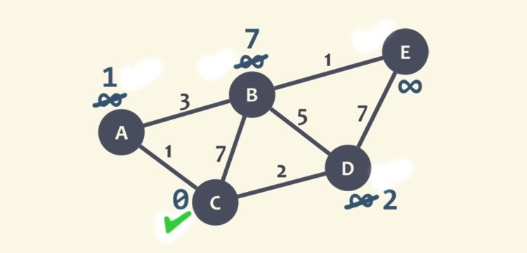
STEP 4
STEP 5
The same is repeated with node D, and marked 2 as lowest value at D.
Since, all the neighbours of node C have checked, so node C is marked as visited with a green check mark.
Assign Node D a minimum distance value
Marked Node C as visited

Slide 14
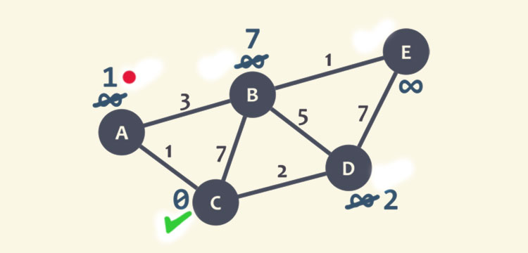
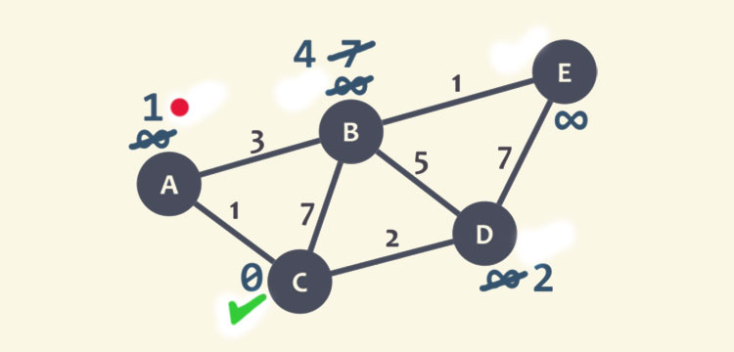
STEP 6
STEP 7
Now, we will select the new current node such that the node must be unvisited with the lowest minimum distance, or the node with the least number and no check mark. Here, node A is the unvisited with minimum distance 1, marked as current node with red dot.
We repeat the algorithm, checking the neighbour of the current node while ignoring the visited node, so only node B will be checked.
For node B, we add 1 with 3 (weight of the edge connecting node A to B) and obtain 4. This value, 4, will be compared with the minimum distance of B, 7, and mark the lowest value at B as 4.
Graphical Representation of Node A as Current Node
Assign Node B a minimum distance value

Slide 15
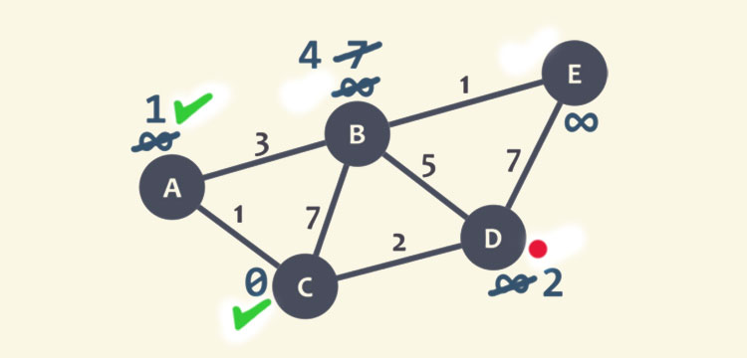
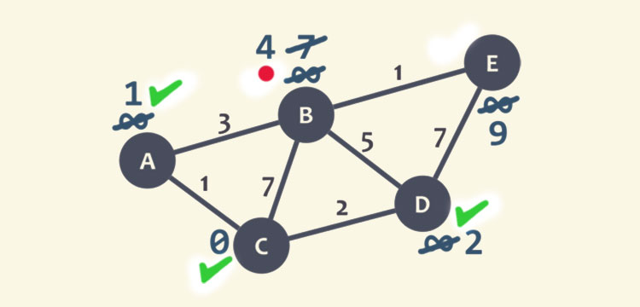
STEP 8
STEP 9
After this, node A marked as visited with a green check mark. The current node is selected as node D, it is unvisited and has a smallest recent distance. We repeat the algorithm and check for node B and E.
For node B, we add 2 to 5, get 7 and compare it with the minimum distance value of B, since 7>4, so leave the smallest distance value at node B as 4.
For node E, we obtain 2+ 7= 9, and compare it with the minimum distance of E which is infinity, and mark the smallest value as node E as 9. The node D is marked as visited with a green check mark.
Graphical Representation of Node D as Current Node
Marked Node D as visited

Slide 16
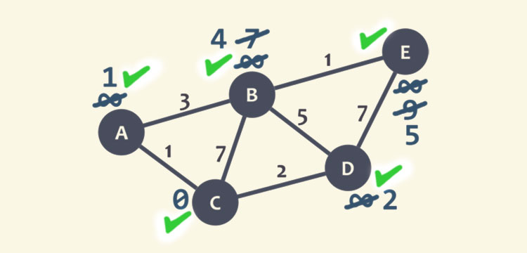
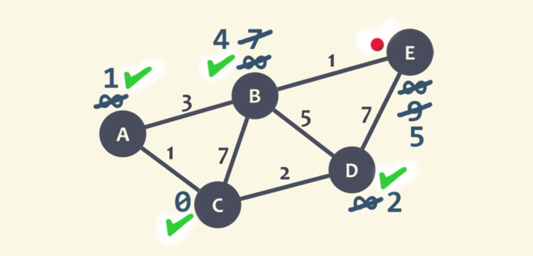
Step 10
Step 11
The current node is set as node B, here we need to check only node E as it is unvisited and the node D is visited. We obtain 4+ 1=5, compare it with the minimum distance of the node.
As 9 > 5, leave the smallest value at node node E as 5.
We mark D as visited node with a green check mark, and node E is set as the current node.
Since it doesn’t have any unvisited neighbours, so there is not any requirement to check anything. Node E is marked as a visited node with a green mark.
So, we are done as no unvisited node is left. The minimum distance of each node is now representing the minimum distance of that node from node C.
Marked Node E as visited
Marked Node B as visited

Slide 17
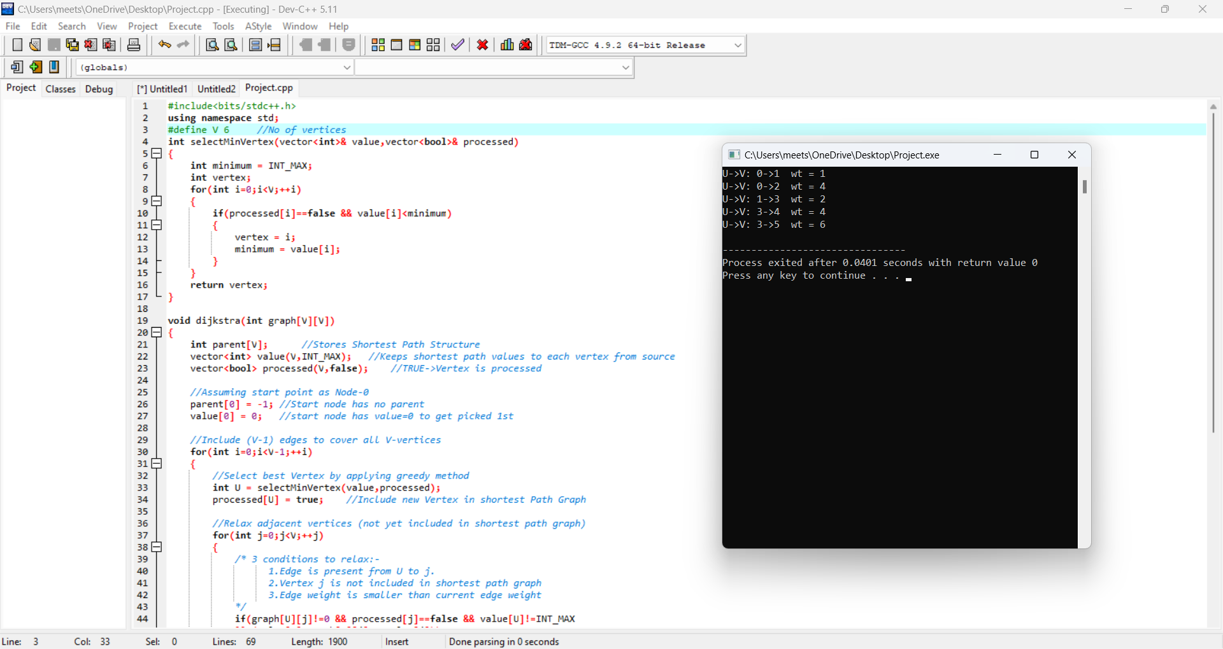
Code Implementation & It’s Output

Slide 18
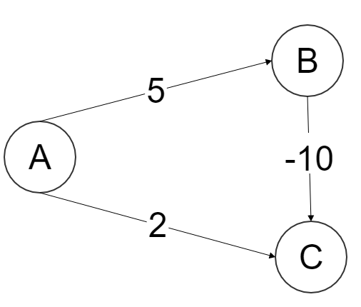
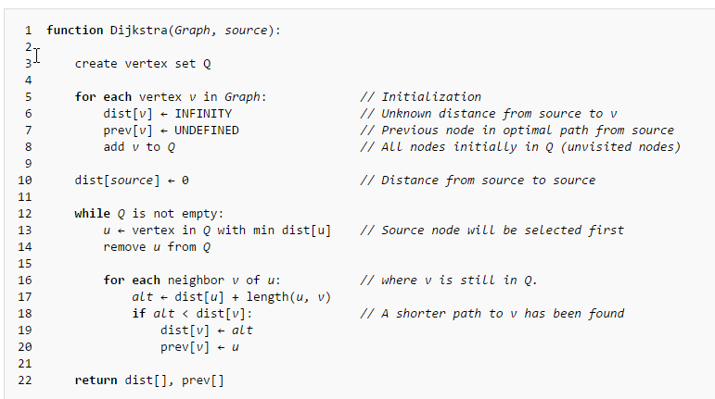
Why Does Not Dijkstra’s Algorithm Work For Negative Weight Edges?
1. So starting out the values (the distance from the source to the vertex) initially assigned to each vertex are,
We first extract the vertex in Q = [A,B,C] which has smallest value, i.e. A, after which Q = [B, C]. Note A has a directed edge to B and C, also both of them are in Q, therefore we update both of those values,

Slide 19
2. Now we extract C as (2<5), now Q = [B]. Note that C is connected to nothing, so line16 loop doesn't run.
Finally we extract B, after which . Note B has a directed edge to C but C isn't present in Q therefore we again don't enter the for loop in line16,
So we end up with the distances as
Note how this is wrong as the shortest distance from A to C is 5 + -10 = -5, when you go .
So for this graph Dijkstra's Algorithm wrongly computes the distance from A to C.
This happens because Dijkstra's Algorithm does not try to find a shorter path to vertices which are already extracted from Q.
3. What the line16 loop is doing is taking the vertex u and saying "hey looks like we can go to v from source via u, is that (alt or alternative) distance any better than the current dist[v] we got? If so lets update dist[v]"
Note that in line16 they check all neighbors v (i.e. a directed edge exists from u to v), of u which are still in Q. In line14 they remove visited notes from Q. So if x is a visited neighbor of u, the path is not even considered as a possible shorter way from source to v.
In our example above, C was a visited neighbour of B, thus the path was not considered, leaving the current shortest path unchanged.
This is actually useful if the edge weights are all positive numbers, because then we wouldn't waste our time considering paths that can't be shorter

Slide 20
4. So I say that when running this algorithm if x is extracted from Q before y, then its not possible to find a path - which is shorter. Let me explain this with an example,
As y has just been extracted and x had been extracted before itself, then dist[y] > dist[x] because otherwise y would have been extracted before x. (line 13 min distance first)
And as we already assumed that the edge weights are positive, i.e. length(x,y)>0. So the alternative distance (alt) via y is always sure to be greater, i.e. dist[y] + length(x,y)> dist[x]. So the value of dist[x] would not have been updated even if y was considered as a path to x, thus we conclude that it makes sense to only consider neighbors of y which are still in Q (note comment in line16)
But this thing hinges on our assumption of positive edge length, if length(u,v)<0 then depending on how negative that edge is we might replace the dist[x] after the comparison in line18.
5. So any dist[x] calculation we make will be incorrect if x is removed before all vertices v - such that x is a neighbour of v with negative edge connecting them - is removed.
Because each of those v vertices is the second last vertex on a potential "better" path from source to x, which is discarded by Dijkstra’s algorithm.
So in the example I gave above, the mistake was because C was removed before B was removed. While that C was a neighbour of B with a negative edge!
Just to clarify, B and C are A's neighbours. B has a single neighbour C and C has no neighbours. length(a,b) is the edge length between the vertices a and b.

Slide 21

THANK YOU

